Slide 1


Data Visualization Design principles
Sheetal Pereira
Assistant Professor
Department of Computer Engineering
K. J. Somaiya College of Engineering
Somaiya Vidyavihar University
Notes:
https://paldhous.github.io/ucb/2016/dataviz/week2.html

Slide 2
Design principles Categorical, time series, and statistical data graphics
Unity/Harmony
Balance
Hierarchy
Scale/Proportion
Dominance/Emphasis
Similarity and contrast

Slide 3
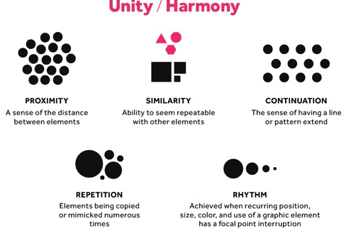
Design principles Categorical, time series, and statistical data graphics
Unity/Harmony

Slide 4
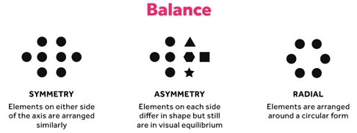
Design principles Categorical, time series, and statistical data graphics
Balance:

Slide 5
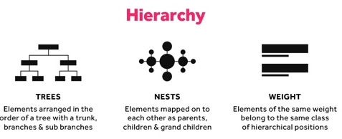
Design principles Categorical, time series, and statistical data graphics
Hierarch

Slide 6
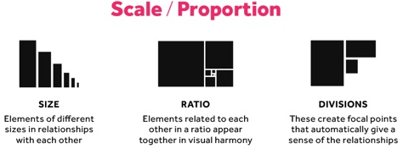
Design principles Categorical, time series, and statistical data graphics
Scale/Proportion:

Slide 7
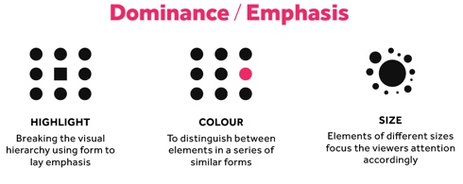
Design principles Categorical, time series, and statistical data graphics
Dominance/Emphasis:

Slide 8
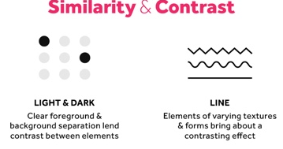
Design principles Categorical, time series, and statistical data graphics
Similarity & Contrast:

Slide 9

Design principles Categorical, time series, and statistical data graphics
Follow these five principles to create compelling and competent visualizations:

Slide 10
Design principles Categorical, time series, and statistical data graphics
1. Tell the truth
There are a plethora of graphs that misguide the reader by showcasing skewed data and projecting false narratives.
The job of the presenter is to inform the audience, not influence them.
Avoid these three misleading methods to ensure that your graphs are clear and honest.

Slide 11
Design principles Categorical, time series, and statistical data graphics
1. Tell the truth
A. Omitting the baseline
Generally, the baseline for a graph should start from zero unless specified otherwise. By starting the baseline from a different number, it can bias the perception of data. This technique is used to make the difference between data points seem to be greater than actual.

Slide 12
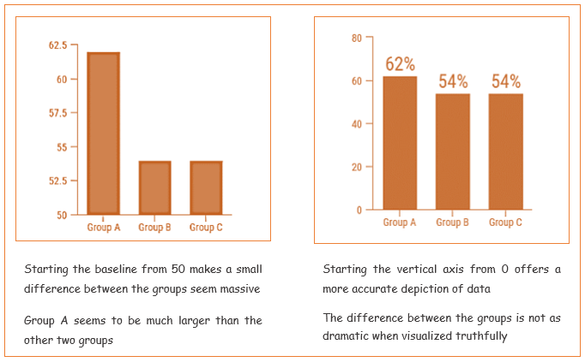
Design principles Categorical, time series, and statistical data graphics
1. Tell the truth
A. Omitting the baseline

Slide 13
Design principles Categorical, time series, and statistical data graphics
1. Tell the truth
B. Going against the conventions
There are certain conventions when plotting data. A larger bar indicates a greater amount, and a bigger area represents a higher number of values. By going against the convention, the viewer is unwittingly led to a wrong inference.

Slide 14
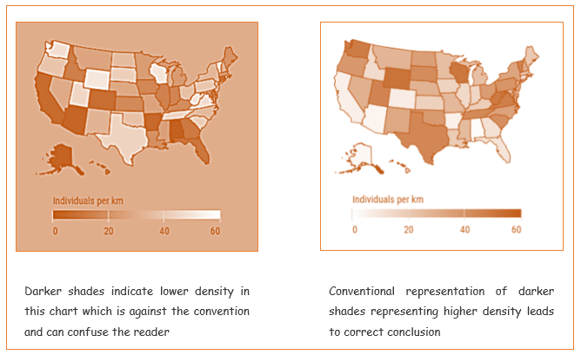
Design principles Categorical, time series, and statistical data graphics
1. Tell the truth
B. Going against the conventions

Slide 15
Design principles Categorical, time series, and statistical data graphics
1. Tell the truth
C. Cherry-picking data
Cherry-picking is when only a few data points are plotted to show a misleading trend. This is one of the most common tactics used to mislead or deceive the audience.

Slide 16
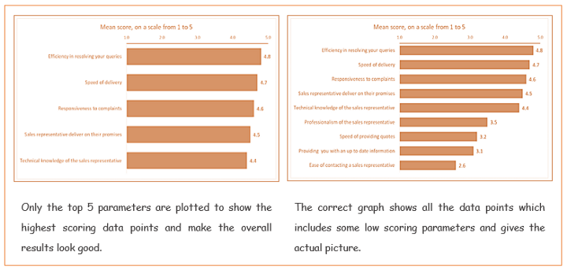
Design principles Categorical, time series, and statistical data graphics
1. Tell the truth
C. Cherry-picking data

Slide 17
Design principles Categorical, time series, and statistical data graphics
_{2. Know your audience}
More often than not, you will be creating data visualizations to communicate information to an audience. The whole point of creating the viz is lost if the message is not conveyed.
Show what you have in a way they want to see.
A good data visualization should resonate with the audience and to make sure that it does, follow these guidelines:-
Display data according to the job role.
Take into consideration the education and expertise of the audience in relation to the topic of the dataviz.
Be sensitive to ethnicity and cultural values.
Focus on the literacy of the audience in terms of technical terms, statistics, language.

Slide 18
Design principles Categorical, time series, and statistical data graphics
2. Know your audience
More often than not, you will be creating data visualizations to communicate information to an audience. The whole point of creating the viz is lost if the message is not conveyed.
Show what you have in a way they want to see.
A good data visualization should resonate with the audience and to make sure that it does, follow these guidelines:-
Display data according to the job role.
Take into consideration the education and expertise of the audience in relation to the topic of the dataviz.
Be sensitive to ethnicity and cultural values.
Focus on the literacy of the audience in terms of technical terms, statistics, language.

Slide 19
Design principles Categorical, time series, and statistical data graphics
four scenarios where you should choose your data viz according to the audience you are presenting for.
A. Based on the job roles
You should present high-level data without too many details to the top-level management, while the various departments should be shown an overall picture with more details of their specific department.

Slide 20
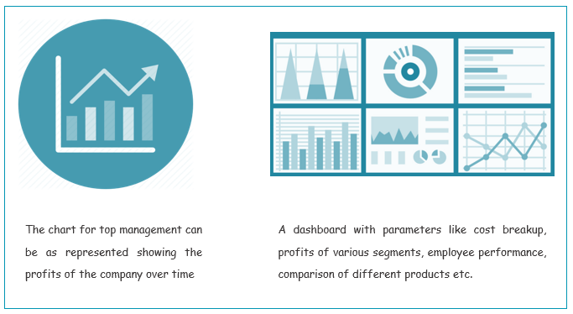
Design principles Categorical, time series, and statistical data graphics

Slide 21
Design principles Categorical, time series, and statistical data graphics
B. Based on technical literacy
Use charts and figures based on the audience’s knowledge of statistics and visualization. You can show more or less complicated information and graphs according to the end-user.

Slide 22
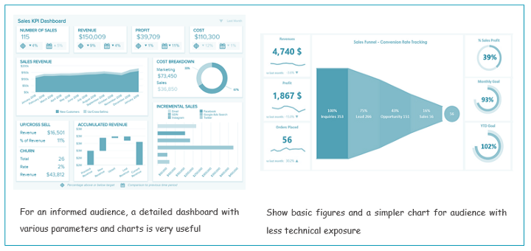
Design principles Categorical, time series, and statistical data graphics

Slide 23
Design principles Categorical, time series, and statistical data graphics
C. Based on background knowledge
You must focus on the facts and numbers in the case of an audience with no prior perception of an issue. Show more details and peripheral information when the audience needs more knowledge about an issue that they are already aware of.

Slide 24
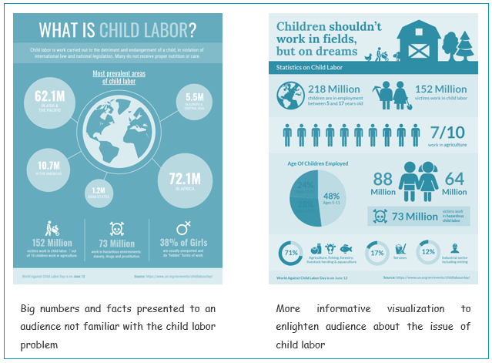
Design principles Categorical, time series, and statistical data graphics

Slide 25
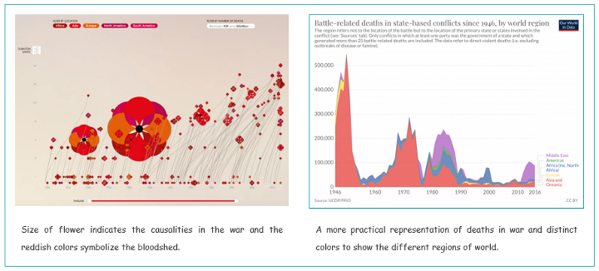
Design principles Categorical, time series, and statistical data graphics
D. Based on emotional disposition
It is a good idea to use emotional appeal with a temperamental audience while focussing more on factual representation with a pragmatic audience.

Slide 26
Design principles Categorical, time series, and statistical data graphics
3. Choose the right chart
Using the wrong chart is like having good intentions but poor execution.
Choose the graph based on the kind of data and the message to be conveyed.
Do not use different graphs just for variety, as specific graphs convey certain types of information more effectively than others.
If not required, do not use any chart — show only numbers.
The right chart enhances information, the wrong one conceals insights.

Slide 27
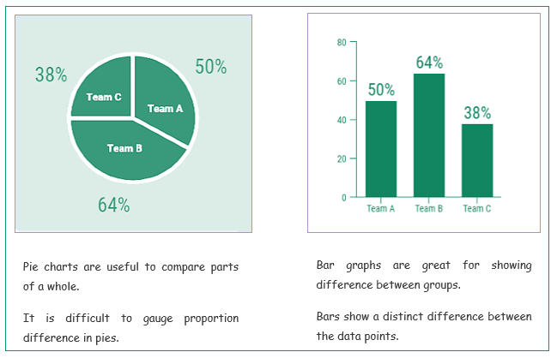
Design principles Categorical, time series, and statistical data graphics
3. Choose the right chart
A. Bar graph instead of a pie chart
When showing comparisons, a bar chart is generally better than a pie chart. It is easier to make out the difference in length of bars than the size of pie segments.

Slide 28
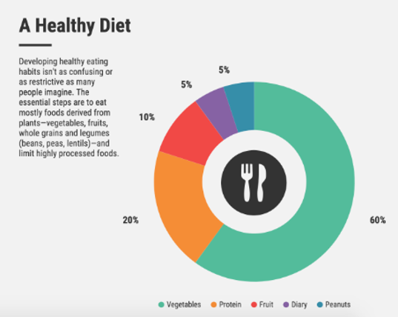
Design principles Categorical, time series, and statistical data graphics
3. Choose the right chart
B. When pie charts are actually useful
Pie charts are great for showing parts of a whole, but only when there are a small number of segments and the difference between the segments is distinct.

Slide 29
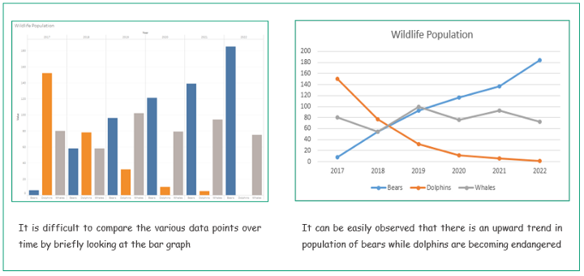
Design principles Categorical, time series, and statistical data graphics
3. Choose the right chart
C. Line graph instead of a bar graph
Line graphs are typically better suited than bar charts to show comparison over time. Also, line charts are very useful to indicate trends or patterns.

Slide 30
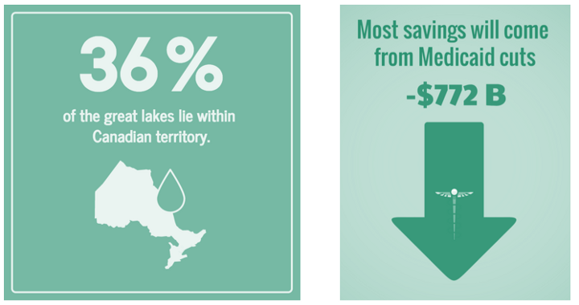
Design principles Categorical, time series, and statistical data graphics
3. Choose the right chart
D. Numbers only instead of any graph
When there is a specific figure to be highlighted, it can be effective to use only numbers with no charts. One or two numbers are easy to grasp and can make a large impact.

Slide 31
Design principles Categorical, time series, and statistical data graphics
4. Emphasize the most important facts
A data visualization can encode many data points, so highlight the most important facts to convey the message faster and with more impact.
Omit the insignificant to highlight the essential!
You can help direct attention on the most important facts by removing noise, such as unnecessary gridlines, axes and labels. Use color, size and pattern to emphasize specific data points or a focus area.
“There is no such thing as information overload. There is only bad design.” — Edward Tufte
The following three cases indicate how to accentuate what you want to communicate to the viewer.

Slide 32
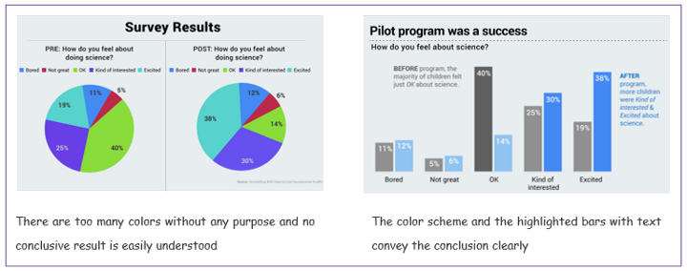
Design principles Categorical, time series, and statistical data graphics
4. Emphasize the most important facts
A. Eliminate distractions
Along with using the right chart, it is important to use colors and text strategically. Moreover, if there is a conclusive result, you should enhance that in the visualization.

Slide 33
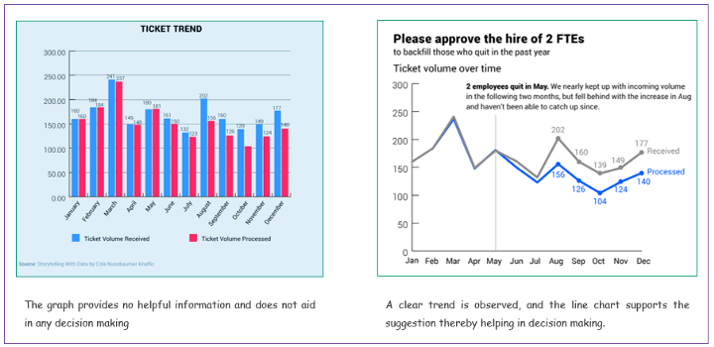
Design principles Categorical, time series, and statistical data graphics
4. Emphasize the most important facts
B. Enhance the essential
It is helpful to use the title to convey the crux of the viz and remove any irrelevant grids, labels and bright colors. You can also use reference lines and text to draw attention to specific points.

Slide 34
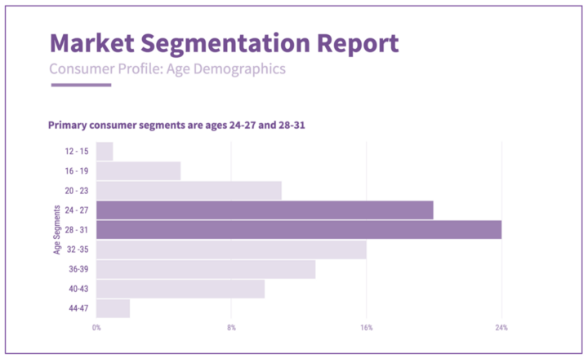
Design principles Categorical, time series, and statistical data graphics
4. Emphasize the most important facts
C. Highlight the significant
A distinct color or even different hue/shade can be used to emphasize important data points and highlight areas for attention.

Slide 35
Design principles Categorical, time series, and statistical data graphics
5. Form should follow function
Aesthetics are important, but should not come at the cost of missing the point. It is more important to communicate the message clearly than to have an eye-candy graph offering no value.
Purpose of data visualization is insights, not pictures.
An intuitive design is more important than appealing charts, and graphs should convey the meaning of data in an easy-to-understand manner.
“Confusion and clutter are failures of design, not attributes of information.” — Edward Tufte
There are many such graphs — here are two that may look fun and pretty but don't successfully impart value to the viewer.

Slide 36
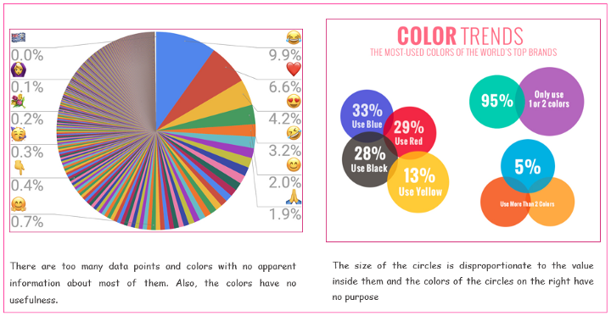
Design principles Categorical, time series, and statistical data graphics
5. Form should follow function

Slide 37
Design principles Categorical, time series, and statistical data graphics
5. Form should follow function
Data is an invaluable resource and data visualization is one of the most effective tools for analysing and communicating interesting ideas and insights from the data. But badly conceived, incorrectly created or downright untruthful visualizations miss the whole point of visualizing data. Remember these basic principles to make your visualizations impactful and prolific!

Slide 38
Design principles of categorical data graphics
Graphical methods for quantitative data are easily generalized; for example, the scatterplot for two variables provides the basis for visualizing any number of variables in a scatterplot matrix; available graphical methods for categorical data tend to be more specialized

Slide 39
Design principles of categorical data graphics
For categorical data, a count is more naturally displayed by an area or by the visual density of an area.

Slide 40
Design principles of categorical data graphics
Goals and Design Principles for Visual Data Display:
Designing good graphics is surely an art, but equally surely, it is one that ought to be informed by science.
In constructing a graph, quantitative and qualitative information is encoded by visual features, such as position, size, texture, symbols and color. This translation is reversed when a person studies a graph.
The representation of numerical magnitude and categorical grouping, and the aperception of patterns and their meaning must be extracted from the visual display.

Slide 41
Design principles of categorical data graphics
Goals and Design Principles for Visual Data Display:
There are many views of graphs, of graphical perception, and of the roles of data visualization in discovering and communicating information.
On the one hand, one may regard a graphical display as a ’stimulus’ – a package of information to be conveyed to an idealized observer.
From this perspective certain questions are of interest: which form or graphic aspect promotes greater accuracy or speed of judgment (for a particular task or question)? What aspects lead to greatest memorability
or impact?

Slide 42
Design principles of categorical data graphics
Balance
Hierarchy
Scale/Proportion
Dominance/Emphasis
Similarity & Contrast.
Simple colors, minimal text and white space work together to tell a clear story.

Slide 43
Design principles of categorical data graphics

Slide 44
Design principles of categorical data graphics
1. Balance the Design:
Equally distribute the visual elements like shape, colour, negative space, and texture across the plot.
Types of balances in design:
1. Symmetrical–Each side of the visual is the same as the other.

Slide 45
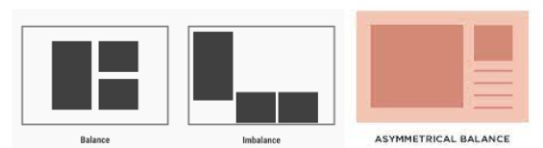
Design principles of categorical data graphics
1. Balance the Design:
2. Asymmetrical–Both sides are different but still have a similar visual weight

Slide 46
Design principles of categorical data graphics
1. Balance the Design:
3. Radial–Elements are placed around a central object which acts as an anchor

Slide 47
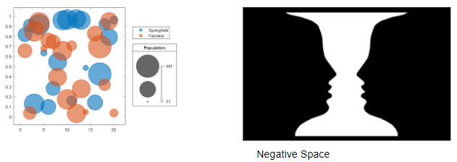
Design principles of categorical data graphics
2. Emphasise the Key Areas
Ensure important data will not get unnoticed
Draw the user’s attention to the right data points by carefully choosing the size, colours, contrast, and negative space.

Slide 48
Design principles of categorical data graphics
3. Illustrating Movement
Movement directs the user’s attention in a certain direction
Visual elements should mimic movement in an “F” pattern, which is how people read.
Starting from top left to right, and gradually down the page.

Slide 49
Design principles of categorical data graphics
4. Smart Use of Patterns
Repeated design elements form a pattern.
Patterns make for a great way to display similar types of information spread across the page as one.
Using similar colours, chart types and elements are the way to go.
Easier to communicate an anomaly, since any disruption in the pattern will naturally draw the viewer’s attention and curiosity.
Using patterns is one of the simplest and most effective design principles when it comes to data visualization.

Slide 50
Design principles of categorical data graphics
5. Proportion
Proportions can indicate the weight of different data sets and the relationship between their values.

Slide 51
Design principles of categorical data graphics
6. Proper Rhythm
Balanced rhythm when the design elements together create a pleasing movement to the eye

Slide 52
Design principles of categorical data graphics
7. Variety
keeps viewers engaged and interested
not only eye-catching but also helps the viewer retain the information presented for longer.
Use apt type of visuals , graphs suitable for the purpose

Slide 53
Design principles of categorical data graphics
8. Theme
Design is consistent and follows a standard.
Incorporate a theme for company or based on the niche of the visualization.
This helps connect with the user on a deeper level and augments the visual design.

Slide 54
Design principles of categorical data graphics
Gestalt Principles:
Gestalt means “unified whole” and is generally associated with the idea that the whole is greater than the sum of its parts. It refers to the patterns that you perceive when presented with a few graphical elements.
The Gestalt Principles consist of several principles that describe how the human brain sees visual information, namely – proximity, similarity, continuity, closure, connection, and enclosure. People, especially designers who understand these principles, can develop visuals that communicate information in the most effective ways.

Slide 55

Design principles of categorical data graphics
Gestalt Principles: Proximity:
The nearer the objects to each other, the more we logically think that these objects belong to the same group
placing visuals closer together encourages the users to think that the grouped visuals are in the same context.
The way the objects are positioned in relation to each other can also make the user unconsciously move their eyes from left to right and/or top to bottom.

Slide 56
Design principles of categorical data graphics
Gestalt Principles: Enclosure:
A group of objects can be enclosed by anything that forms a visual border around them
This enclosure causes the objects to appear to be set apart in a region that is distinct from the rest of what we see.

Slide 57

Design principles of categorical data graphics
Gestalt Principles: Closure:
Our eyes tend to add any missing pieces of a familiar shape that is distinct from the rest of what we see.

Slide 58

Design principles of categorical data graphics
Gestalt Principles: Continuity:
We perceive objects as belonging together, as part of a single whole, if they are aligned with one another or appear to form a continuation of one another.
It’s like the closure principle, but besides the visual connection to form shape, we also attach visual direction as part of the continuation.

Slide 59
Design principles of categorical data graphics
Gestalt Principles: Connection:
We perceive objects that are connected in some way, such as by a line, as part of the same group

Slide 60
Design principles of categorical data graphics
Gestalt Principles: Figure and Ground
We add information based on our imagination

Slide 61
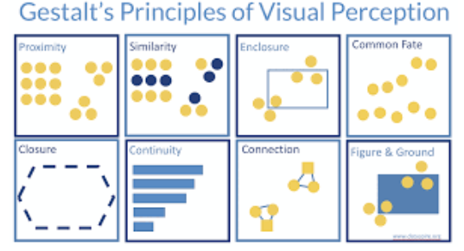
Design principles of categorical data graphics
Gestalt Principles: Figure and Ground
We add information based on our imagination

Slide 62
Design principles of categorical data graphics
Here are some other principles to consider:
Choose Appropriate Graph Type: Select a graph type that effectively displays categorical data. Common options include bar charts, pie charts, stacked bar charts, and grouped bar charts.
Clear Labels and Titles: Clearly label the graph with a descriptive title that conveys the purpose of the visualization. Label the categorical variables on the appropriate axes, and use concise and informative labels for categories.
Consistency in Ordering: Order the categories logically on the graph. You can order them by frequency, alphabetical order, chronological order, or any other meaningful criterion.
Color and Contrast: Use distinct and contrasting colors for different categories to make them visually distinguishable. Ensure that the colors you choose are accessible and don't cause confusion.
Avoid Overcrowding: If you have many categories, consider grouping or aggregating them to prevent overcrowding the graph. This makes the graph easier to read and interpret.
Legend: If you're using colors or patterns to represent categories, include a legend that explains the meaning of each color or pattern. Place the legend where it's easily visible but doesn't obstruct the data.
Data Labels: Add data labels to individual bars or segments in a pie chart to provide exact values. This helps viewers understand the proportions of each category.
Avoid 3D Effects: Avoid using 3D effects or other unnecessary embellishments that can distort the data or make the graph difficult to read.

Slide 63
Design principles of categorical data graphics
Annotations: Use annotations, such as arrows or text boxes, to highlight specific categories or explain unusual patterns.
Data Hierarchy: If your categorical data has subcategories or levels, use different colors or patterns to represent these levels. This adds another layer of information.
Percentage Representation: In a pie chart, consider displaying the actual percentages within or near each segment for a clearer representation of the distribution.
Explode Segments (Pie Chart): If you want to emphasize a specific category in a pie chart, you can "explode" or pull out that segment slightly from the center.
Consistent Widths (Bar Charts): In a bar chart, maintain consistent widths for bars to accurately represent the differences between categories.
Avoid Overlapping Labels: If you have a large number of categories or long labels, rotate the labels or use alternate labeling strategies to avoid overlapping text.
Whitespace: Use whitespace effectively to separate categories and make the graph easier to read.
Contextual Information: Provide relevant context about the data source, time period, sample size, and any necessary explanations to aid in interpretation.
Accessibility: Ensure that your graphical representation is accessible by using high-contrast colors, providing alternative text for screen readers, and avoiding excessive reliance on color alone to convey information.
By applying these principles, you can create clear and informative visualizations that effectively communicate the distribution and patterns within categorical data.

Slide 64
Design principles of time series data graphics
A time series is a sequence of data points that occur in successive order over some period of time.
In investing, a time series tracks the movement of the chosen data points, such as a security’s price, over a specified period of time with data points recorded at regular intervals.
There is no minimum or maximum amount of time that must be included, allowing the data to be gathered in a way that provides the information being sought by the investor or analyst examining the activity.

Slide 65
Design principles of time series data graphics
A time series is a data set that tracks a sample over time.
In particular, a time series allows one to see what factors influence certain variables from period to period.
Time series analysis can be useful to see how a given asset, security, or economic variable changes over time.
Forecasting methods using time series are used in both fundamental and technical analysis.

Slide 66
Design principles of time series data graphics
Representing time series data graphically involves applying several principles to effectively convey the information and insights present in the data. Here are some key principles:
Time on the X-axis: In time series graphs, the independent variable (time) is typically plotted along the horizontal X-axis. This ensures that the chronological order of events is maintained.
Data on the Y-axis: The dependent variable (the data you're tracking over time) is plotted on the vertical Y-axis. This axis represents the values or measurements being recorded.
Clear Labels and Titles: Use descriptive labels and titles for both axes and the graph itself. This helps viewers understand what is being represented without confusion.

Slide 67
Design principles of time series data graphics
Consistent Intervals: Maintain consistent intervals on the X-axis. If the data points are irregularly spaced, consider using connecting lines to indicate the time progression smoothly.
Scaling: Choose appropriate scaling for both axes. Scaling should ensure that the graph uses the available space effectively without distorting the data. Common scaling methods include linear, logarithmic, and percentage scales.
Visual Clarity: Use clear and easy-to-read fonts for labels, titles, and data points. Avoid overcrowding the graph with excessive information that might make it difficult to interpret.
Color and Contrast: Use colors and contrasts that are visually appealing and distinguishable. If multiple lines or data series are plotted on the same graph, use different colors or line styles to differentiate them.

Slide 68
Design principles of time series data graphics
Legend: If you're plotting multiple data series on the same graph, include a legend to explain what each line represents. The legend should be placed in a way that it doesn't obscure the data.
Data Density: Avoid overcrowding the graph with too many data points. Depending on the size of the graph and the resolution, you might need to aggregate data points for better visualization.
Annotations: Use annotations, such as arrows, text boxes, or markers, to highlight important events, trends, or anomalies in the time series. This adds context and helps viewers understand key points.
Trend Lines and Averages: Add trend lines or moving averages to highlight overall trends and smooth out noise in the data, making it easier to identify patterns.
Gridlines: Gridlines on both axes can help viewers accurately read values from the graph. They provide a visual reference to the data points.

Slide 69
Design principles of time series data graphics
Time Periods: If the time series covers multiple time periods (e.g., days, months, years), consider labeling the major time intervals on the X-axis for better comprehension.
Contextual Information: Provide additional information about the data source, units of measurement, and any relevant contextual details that could aid in interpretation.
Interactivity: In digital formats, consider adding interactivity that allows users to zoom in, pan, or toggle different data series on and off for a more customized viewing experience.
By applying these principles, you can create clear and informative time series visualizations that effectively communicate insights from your data.

Slide 70
Design principles of statistical data graphics
Statistical data are the outcomes or the observations which occur in scientific experiments or an investigation.
To conduct any analysis it is must to have some data .
Without data we can not think about research or statistical analysis.
In statistics, data plays a vital role in all fields and all the theories and measurement.
Measure of central tendency(mean,median,mode), measure of dispersion (variance,mean deviation, standard deviation etc)are some statistical measure by which we find the different characteristics of the data.
For example, In a garments factory, we want to find the female workers’ height and weight. If we consider the size in feet and weight in kilograms,then we get some numerical values, which are the numerical data.

Slide 71
Design principles of statistical data graphics
Types of statistical data
All statistical data may be classified into two categories:
Qualitative: Gender, Education status, marital status etc
Quantitative: Age, height, weight etc

Slide 72
Design principles of statistical data graphics
We can divide data into 2 categories based on data collection as,
Primary data: collected from individuals directly and these data has never been used for any purpose earlier.
Secondary data: The data which had been collated by some individual or agency and statistically treated to draw certain conclusions.The same data are used and analyzed to extract some other information,which is termed as secondary data.

Slide 73
Design principles of statistical data graphics
Methods of data collection
Direct personal inquiry method
Indirect oral investigation
By mailed questionnaires
Information from local agents by old records
By direct observational method

Slide 74
Design principles of statistical data graphics
Requirements of reliable statistical data
It should be complete
It should be consistent
It should be accurate
It should be homogenous with respect to the unit of information.

Slide 75
Design principles of statistical data graphics
5 Design principles of statistical data graphics
1. Show the data clearly
Showing the data clearly includes ensuring the data points can be seen but also providing meaningful text on the graph itself. Tips include:
Check the data points plotted can be detected, and are not covered up or obscured.
Don't assume the viewer is a mind-reader ... label titles and axes clearly and accurately.
Maintain constant measurement scales and avoid distortions.

Slide 76
Design principles of statistical data graphics
5 Design principles of statistical data graphics
2. Use simplicity in design of the graph
A graph with a simple design strives for a clean, uncluttered look. Simplicity in design does not mean simplicity in data however; well-designed graphs can represent rich data.
Avoid distortions, shading, perspective, volume, unnecessary colour, decoration or pictograms, and 3D.

Slide 77
Design principles of statistical data graphics
5 Design principles of statistical data graphics
3. Use alignment on a common scale
Good graphs support accurate estimation of the quantities represented. To estimate quantities, the reader needs to understand the scale used to represent quantity on the graph.
Use a single linear scale whenever possible.
Use a common scale if a single scale is not possible, for example, when using panels.
Avoid pie charts, doughnut charts, stacked bar charts.
Add gridlines to assist with accurate comparison and estimation; a grey background with white gridlines is often effective.

Slide 78

Design principles of statistical data graphics
5 Design principles of statistical data graphics
3. Use alignment on a common scale

Slide 79
Design principles of statistical data graphics
5 Design principles of statistical data graphics
3. Use alignment on a common scale
Consider transposing a figure to find the easiest way to display the common scale.
The 2016 popular vote in the US Presidential election provides a simple example of a transposition:

Slide 80
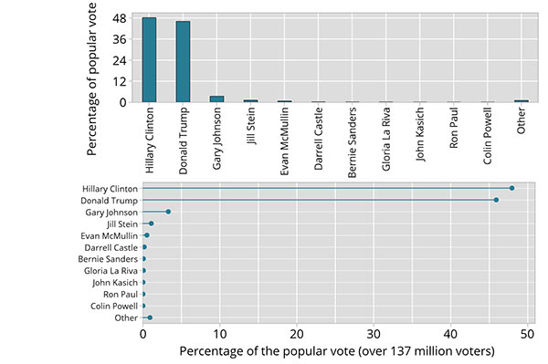
Design principles of statistical data graphics
5 Design principles of statistical data graphics
3. Use alignment on a common scale

Slide 81
Design principles of statistical data graphics
5 Design principles of statistical data graphics
4. Keep the visual encoding transparent
Graphs use visual encoding to represent data. Readers need to decode the graph. This works best when the decoding task is made easy by astute choices in the design of the graph, making the visual encoding transparent and the decoding effortless. Here are some tips:
Follow principles 1, 2 and 3!
Use a common scale if a single scale is not possible.
Consider how the ordering of elements affects decoding.
Use colour and shading with meaning.
Solve detection problems with
panels
open circles or small points
jittering

Slide 82
Design principles of statistical data graphics
5 Design principles of statistical data graphics
5. Use standard forms that work
Accurate interpretation of graphs relies on a shared understanding of the definition of the graphical objects used. Using standard forms for standard needs supports more reliable interpretation of data visualisations.
Adhere to the principles that define graphical objects.
Use standard forms
Dotplot
Histogram
Boxplot
Time series plot
Bar chart or dot chart
Line plot of estimates
Estimates as points, with confidence interval bars

Slide 83
Design principles of statistical data graphics
Here are some principles to consider:
Choose the Right Graph Type: Select a graph type that is appropriate for the type of data and the message you want to convey. Common graph types include bar charts, line graphs, scatter plots, pie charts, histograms, and box plots.
Simplicity: Keep the graph simple and focused on conveying the main message. Avoid cluttering the graph with excessive data or decorative elements that don't contribute to understanding.
Labels and Titles: Clearly label both axes, providing units of measurement if necessary. Include a descriptive title that succinctly conveys the purpose of the graph.
Consistency: Maintain consistent formatting and design elements across graphs within the same presentation or report. This consistency makes it easier for viewers to compare and understand the data.
Scale Appropriately: Choose appropriate scales for both axes. Scaling should accurately represent the data without distorting the visual perception. Avoid manipulating scales to exaggerate differences or trends.
Axis Intervals: Use appropriate intervals for tick marks on the axes. Ensure that the intervals are easy to read and understand. If necessary, use labels to show cumulative data.

Slide 84
Design principles of statistical data graphics
Color Selection: Use a limited and cohesive color palette to distinguish different data elements. Ensure that the colors you choose are easily distinguishable for viewers with color vision deficiencies.
Annotations: Include annotations, such as text labels, arrows, or callouts, to highlight specific data points, trends, or significant events in the data.
Data Integrity: Avoid distorting the data by using 3D effects, exaggerated visual elements, or inappropriate scaling. Always strive to represent the data accurately.
Data Hierarchy: Use graphical elements (like different colors or patterns) to represent subcategories within the data. This helps viewers understand the hierarchy and relationships.
Legend: If the graph includes multiple data series, provide a legend that explains what each element represents. Place the legend where it doesn't obscure the data

Slide 85
Design principles of statistical data graphics
Gridlines: Use gridlines sparingly to guide the viewer's eyes along the data points. Overuse of gridlines can clutter the graph.
Data Labels: Add data labels, especially for individual data points on a bar chart or scatter plot. This can provide specific values and aid in interpretation.
Whitespace: Utilize whitespace strategically to separate data elements and make the graph more visually appealing.
Contextual Information: Provide context about the data source, time period, sample size, and any relevant explanations that help viewers interpret the graph accurately.
Consistency in Symbols: If you use symbols (e.g., markers on a scatter plot), ensure that they are consistent across different graphs or data points.
Accessibility: Ensure that your graphs are accessible to a diverse audience, including individuals with disabilities. Provide alternative text for screen readers and choose colors that are legible for all users.
By applying these principles, you can create graphical representations of statistical data that effectively communicate insights and support data-driven decision-making.

Slide 86
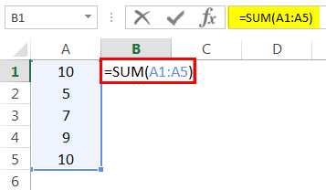
Microsoft excel formulas
SUM:
Example
=SUM(A1:A5)
Result = 41 (See Image below)

Slide 87
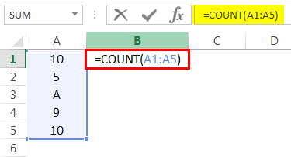
Microsoft excel formulas
COUNT:This basic Excel function counts the numeric value in one or more cells or ranges.
Ans is 4

Slide 88
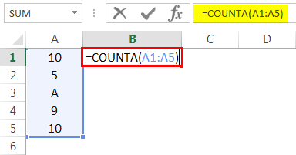
Microsoft excel formulas
COUNTA: This formula counts the value in one or more cells (This will measure the cells irrespective of the number or text value).
Ans is 5

Slide 89
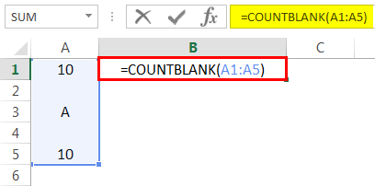
Microsoft excel formulas
COUNTBLANK in Excel
This Excel basic function counts the blank value in the range. (Note: We will not consider only space in a cell a blank cell).
Ans is 2

Slide 90
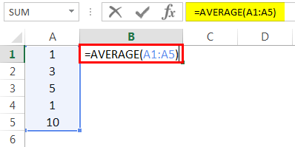
Microsoft excel formulas
AVERAGE in Excel
This basic formula in Excel is used to get the value average in one or more cells or ranges.
Ans is 4

Slide 91
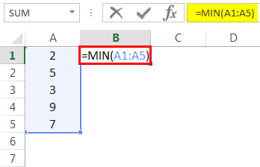
Microsoft excel formulas
MIN Formula in Excel
This Excel basic function is used to get the minimum value in cells or ranges.
Ans is 2

Slide 92
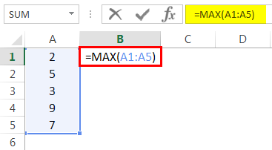
Microsoft excel formulas
MAX Formula in Excel
This basic Excel function gets the maximum value in cells or ranges.
Ans is 9

Slide 93
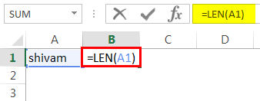
Microsoft excel formulas
LEN in Excel
This basic function of Excel calculates the number of characters in a cell or text.
Ans is 6

Slide 94
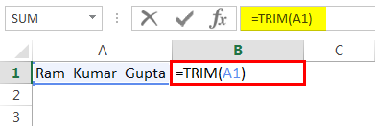
Microsoft excel formulas
TRIM in Excel
This basic Excel function removes unnecessary space in a cell or text.
Ans is: Ram Kumar Gupta

Slide 95
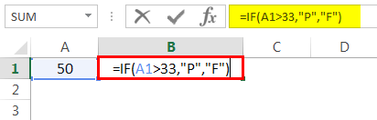
Microsoft excel formulas
IF in Excel
IF function can perform a logical test in Excel.
=IF(A1>33,”P”,”F”). A value in cell A1 is 50, and a logical test is if the value is greater than 33. Then the result would be P. Else, the result would be F.

Slide 96
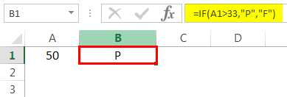
Microsoft excel formulas
IF in Excel
Since the value 50 is greater than 33, the result would be P. (See image below).

Slide 97
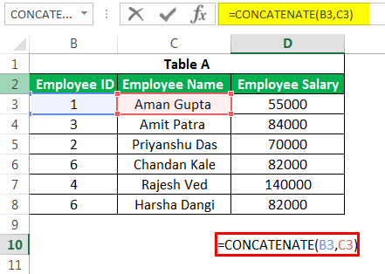
Microsoft excel formulas
CONCATENATE Formula in Excel
It is one of the formulas used with multiple variants, which helps us join several text strings into one text string.
For example, if we want to show “Employee ID” and “Employee Name” in a single column.

Slide 98
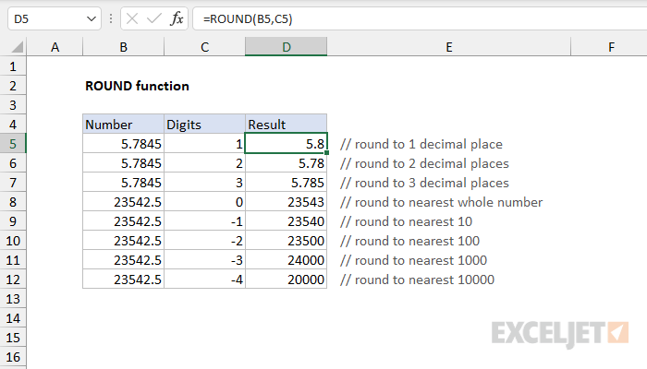
Microsoft excel formulas
ROUND Formula in Excel

